Slide 1

Social Mobility and Education
Date Science in Techno-Socio-Economic Systems
19. May 2025

Slide 2





Motivation
Education
Family
REligion
Influence
Global
Years of studies
Household assests available
Highest education
Education Father
Education Mother
Number of siblings
Christian, Muslim, Hindu, etc.
Different Caste
Education compared to other Attributes
Relevance
Intercontinental
Cross-country differences

Slide 3
Open Questions
Education
Family
Does education tell us anything about current / future income?
Does the environment in which a person is growing up tell us something about current / future income?
Religion
Influence
Is the prediction biased on the religion or culture one has.
If measurable, how much influence do different kinds of attributes (features) have on the predictions?
Global
General
Are there cross-country differences in mobility patterns?
How to find these correlations?

Slide 4
How to find these correlations?
Neural Network
For learning highly complex, non-linear patterns
Random Forest
Captures complex, non-linear relationships
Multiple Linear Regression
Quickly interprets linear relationships

Slide 5

Country Analysis

Slide 6
Country Analysis
USA

Slide 7
Country Analysis
USA
Germany

Slide 8
Country Analysis
India
USA
Germany

Slide 9
Hypothesis
The combination of education level and environmental quality metrics predicts income mobility better than either factor alone.
Higher levels of individual education are associated with increased upward social mobility, as measured by a weaker correlation between other features such as parental income, parental education, …

Slide 10
USA (aggregate data)

Slide 11
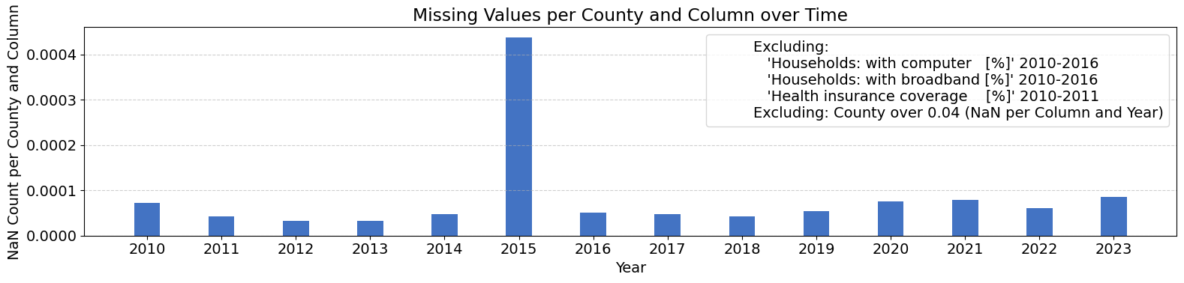
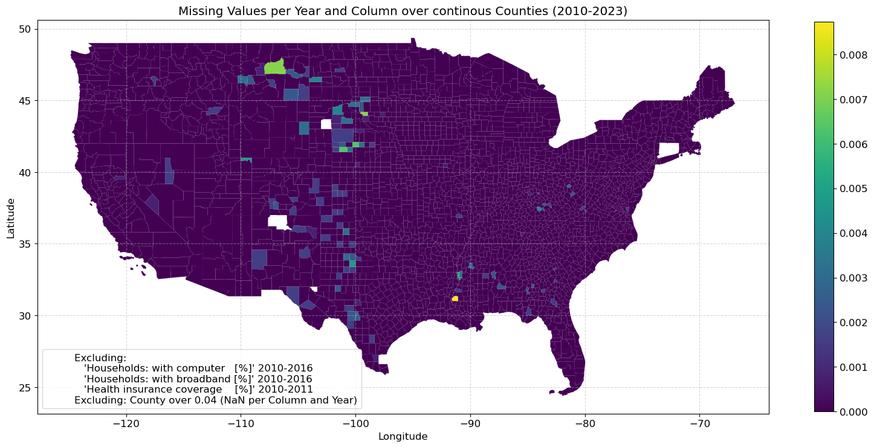
Data & Model
Data
U.S. Census Bureau: America Community Survey: 5-Year Estimates Data Profiles
U.S. Census Bureau: Tiger Shapefile
Tables: 14 * 5 = 70
Timeframe: 2010-2023
Geographic Scope: Continious Mainland U.S. Counties
Model
LSTM-based Model
High Total Feature Dropout
73 Features
3 Year Context Window

Slide 12
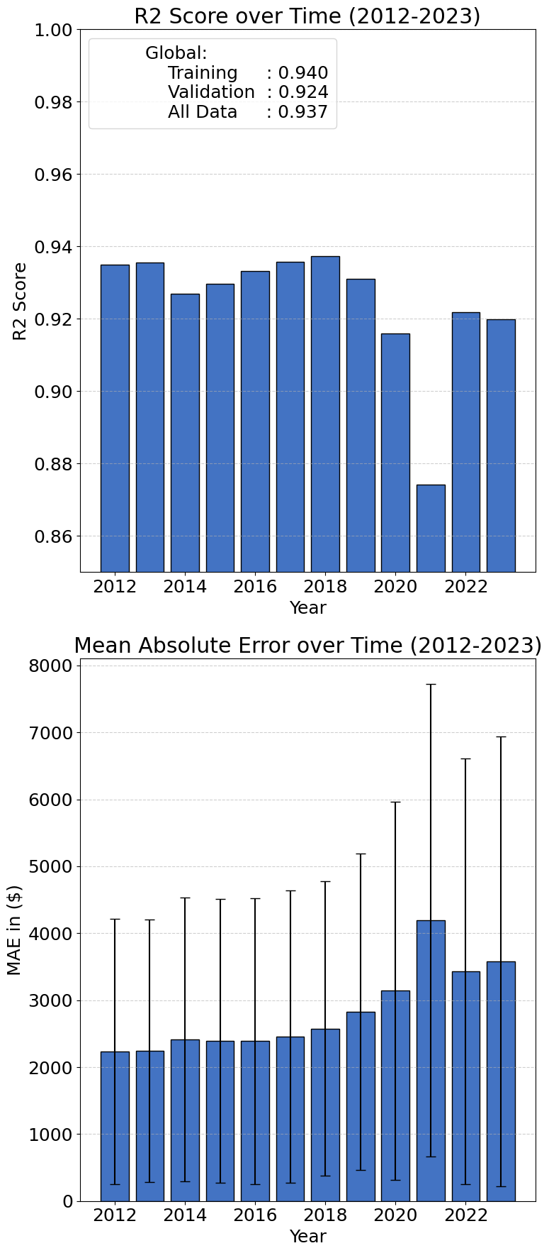
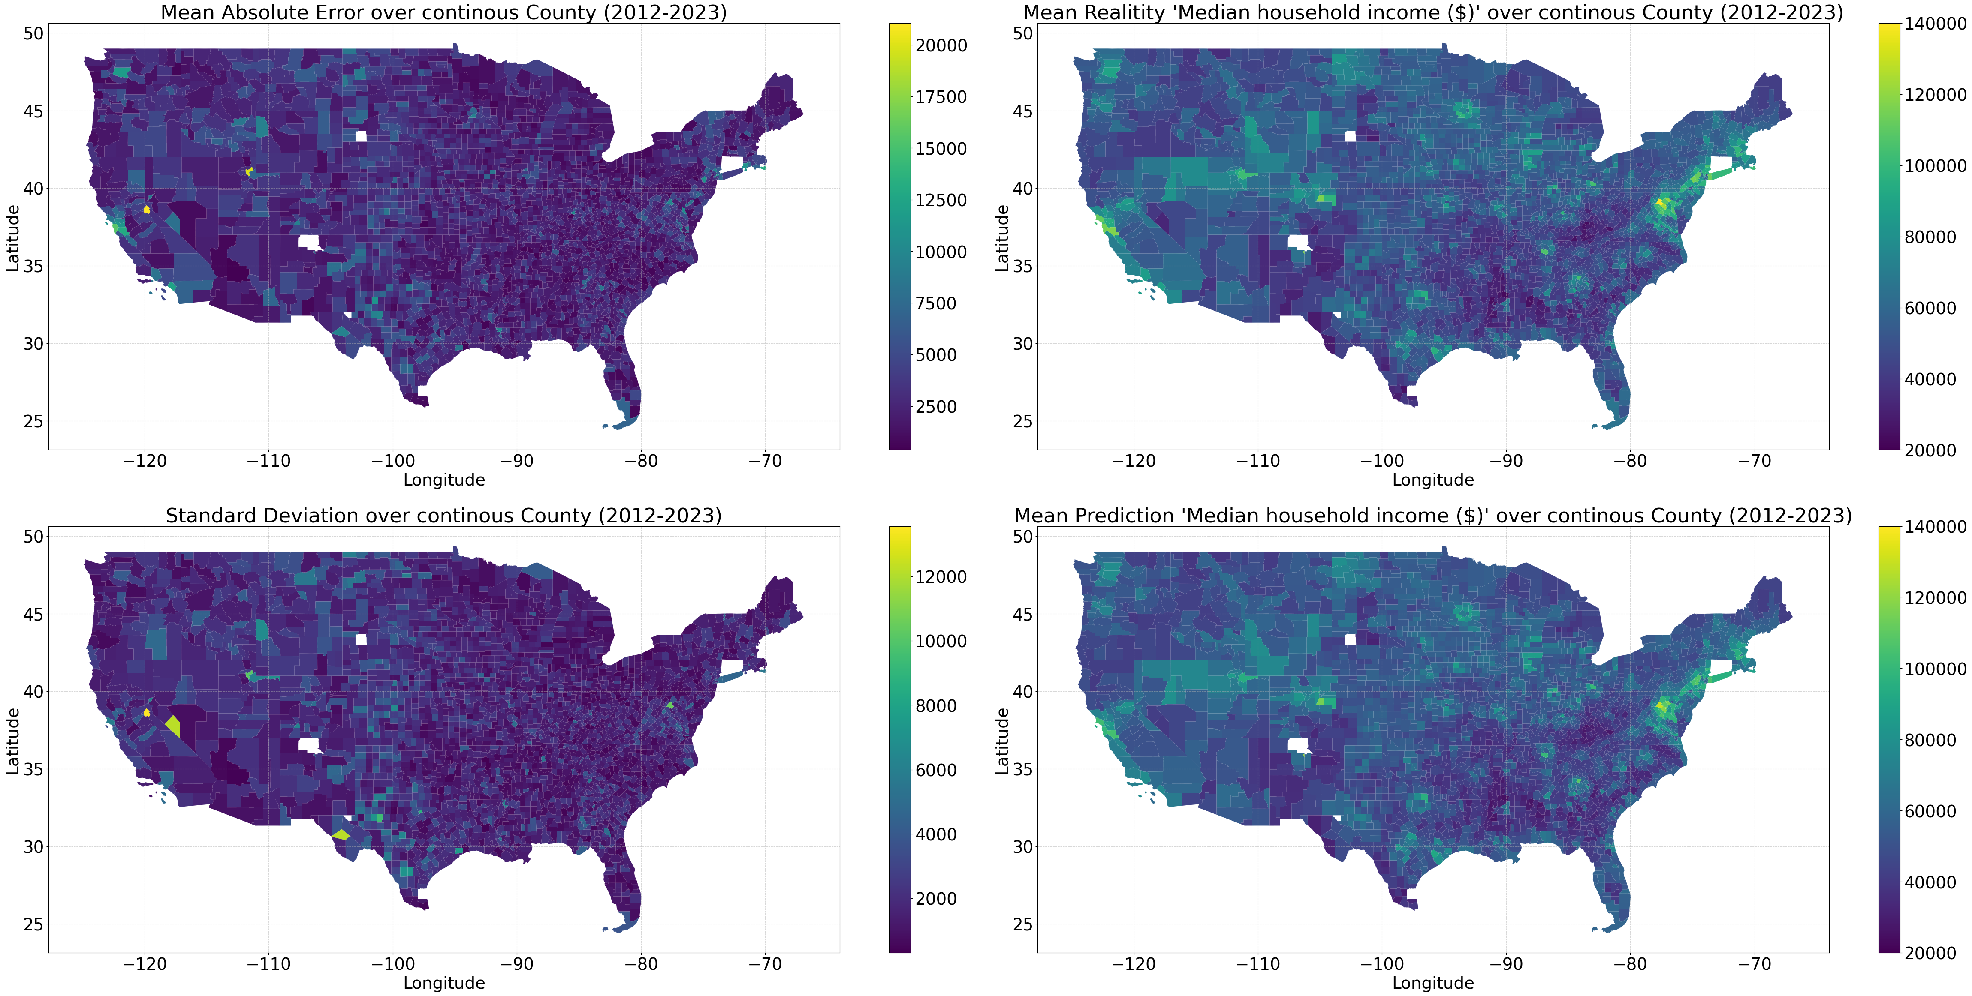
Model Quality

Slide 13
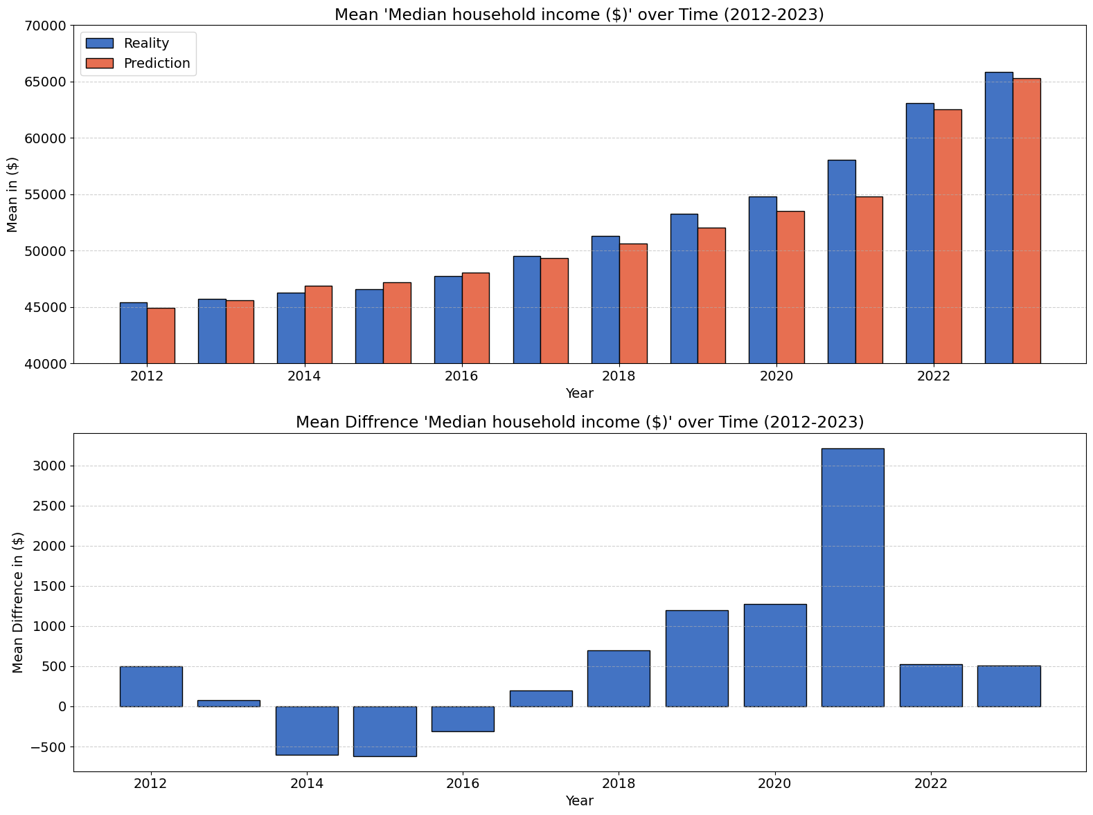
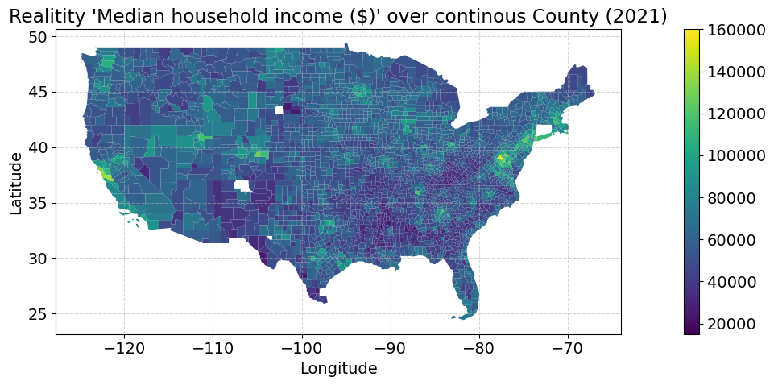

Prediction

Slide 14
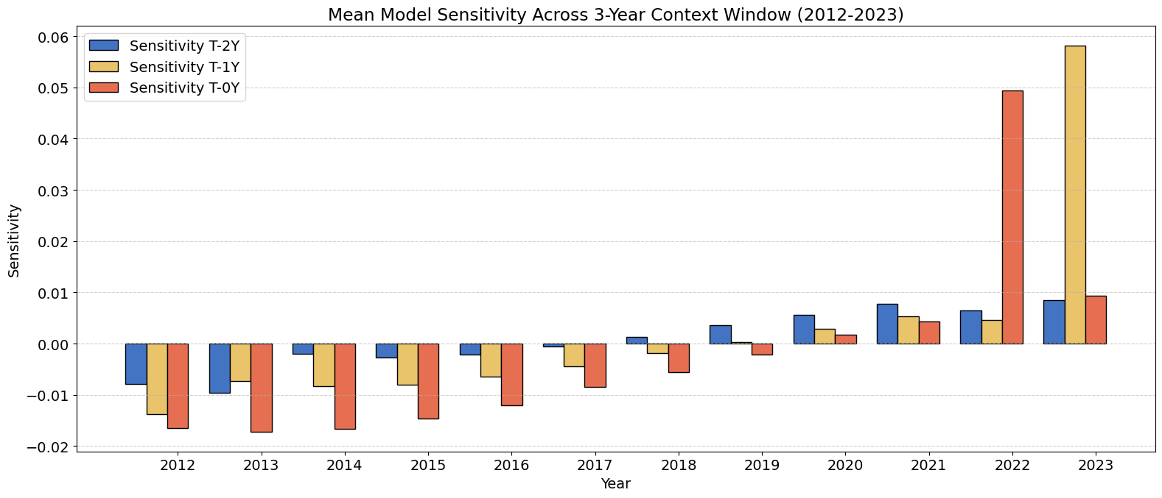
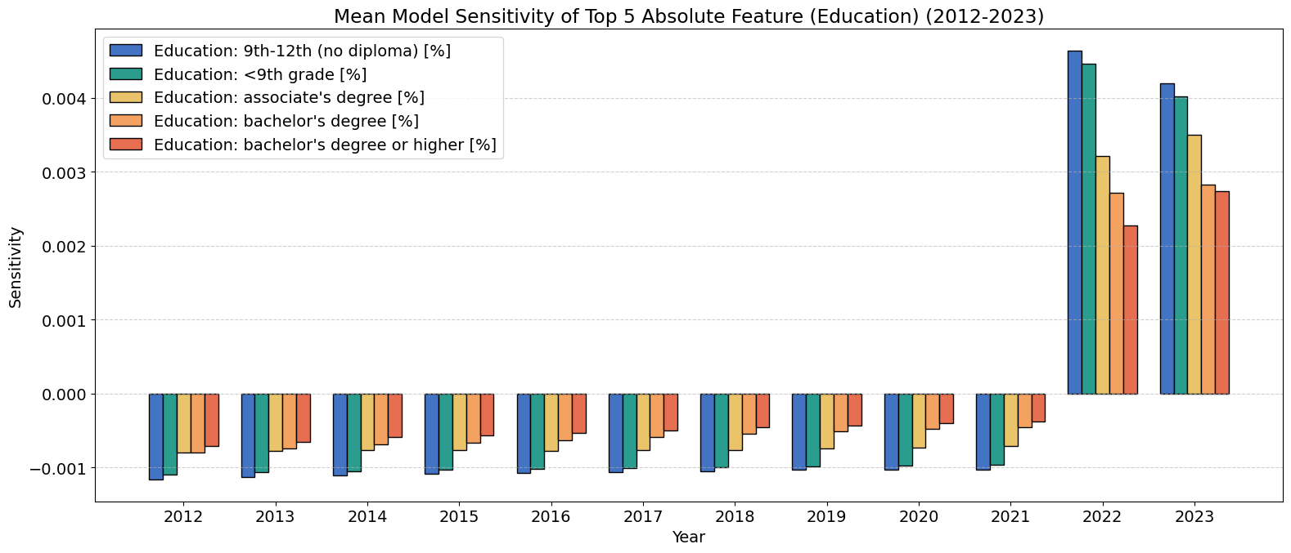
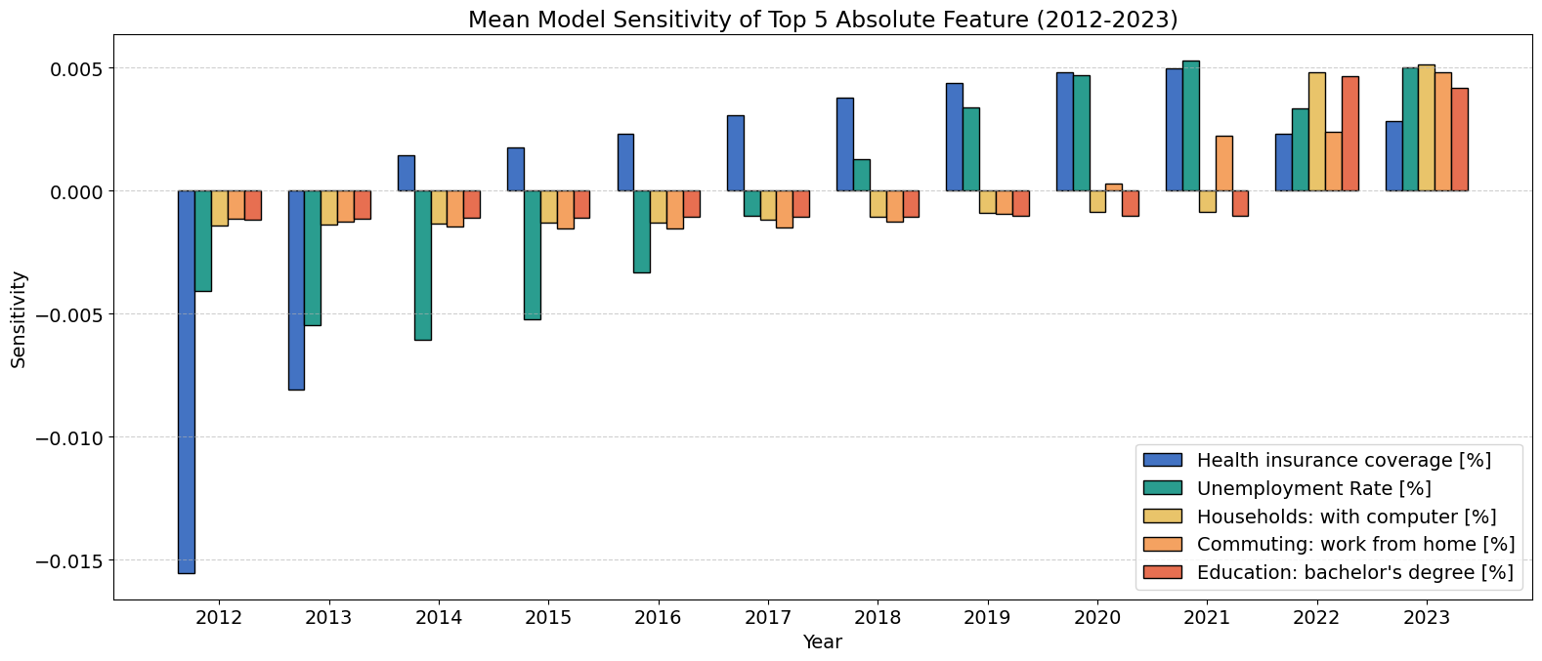
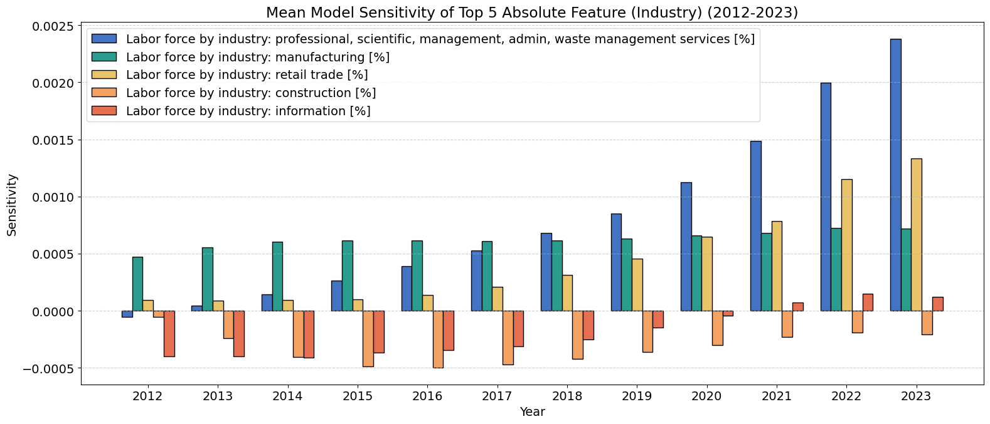
Sensitivity Analysis

Slide 15
Germany (aggregate data)

Slide 16
Resources
Dataset
Methods
Aggregated data: no individuals information
County level: 390 / 476 Landeskreise
Time span: 10 years
Total samples: 3900
Models
Random Forest (RF) classification of income classes
Multiple linear regression (MLR)
Train (80%) and Test (20 %) splits:
Split randomly with 30 different seeds
Mean and standard deviation estimation
Feature Importance:
Random forest: Permutation feature importance (rank)
MLR: Fitted coefficients
limitation due to data quality
_{Data and shapefile sources:}
© Statistisches Bundesamt (Destatis), GENESIS-Online, https://www.regionalstatistik.de/genesis/online, accessed on: [2025]
© BKG (2025) dl-de/by-2-0, Datenquellen: https://sgx.geodatenzentrum.de/web_public/gdz/datenquellen/Datenquellen_vg_nuts.pdf

Slide 17
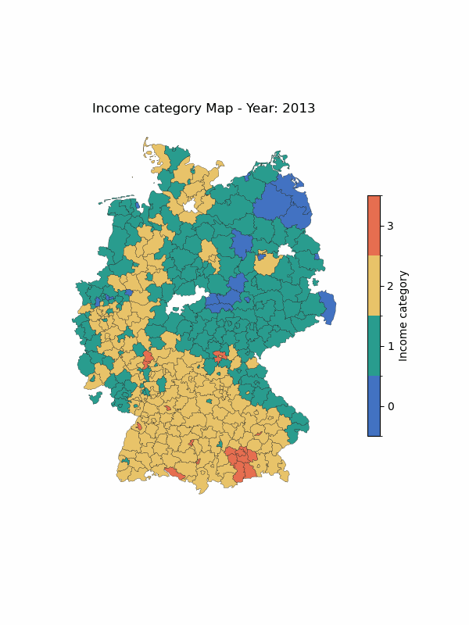
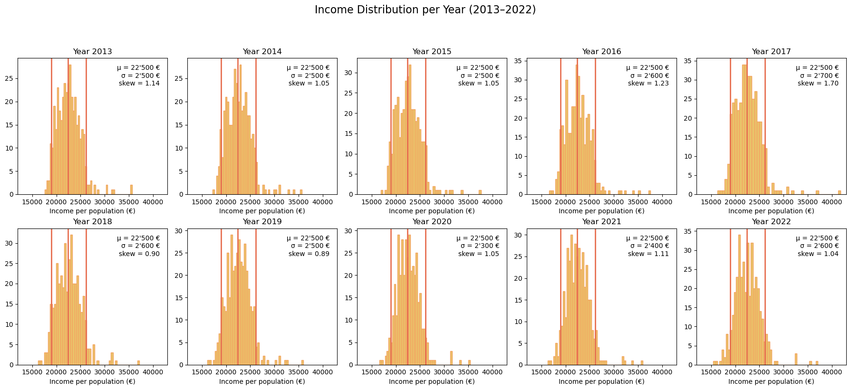
Income Categories
Category 0: < 5th percentile
Category 1: 5th - 50th percentile
Category 2: 50th - 95th percentile
Category 3: >95th percentile

Slide 18
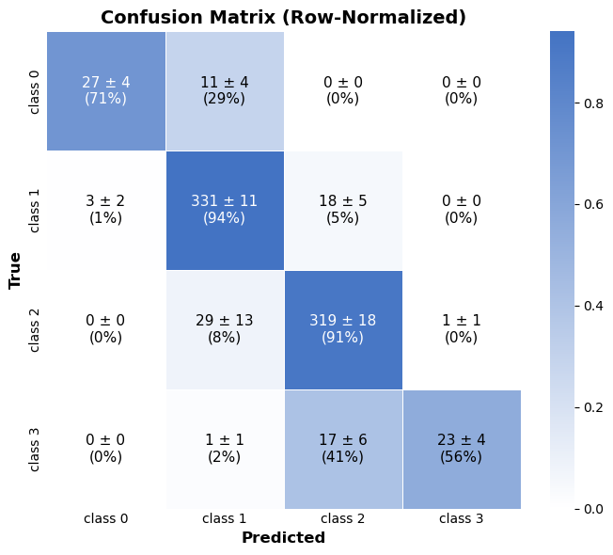
Classification
Random Forest
Overfitting
Mean test accuracy: 0.897 ± 0.018
Mean train accuracy: 1 ± 0

Slide 19
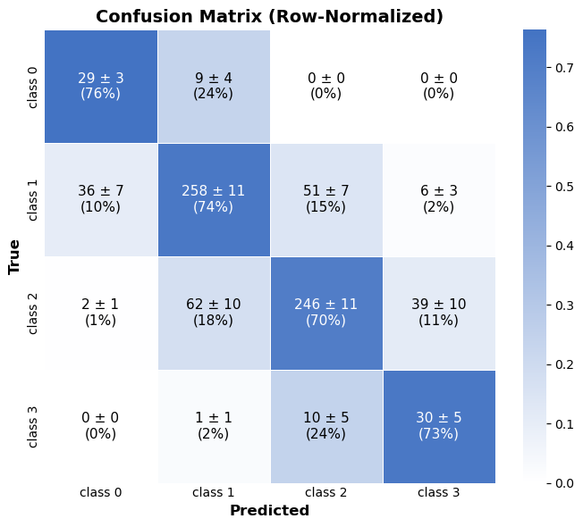
Classification
Random Forest
Preventing overfitting
Mean test accuracy: 0.723 ± 0.019
Mean train accuracy: 0.780 ± 0.008

Slide 20
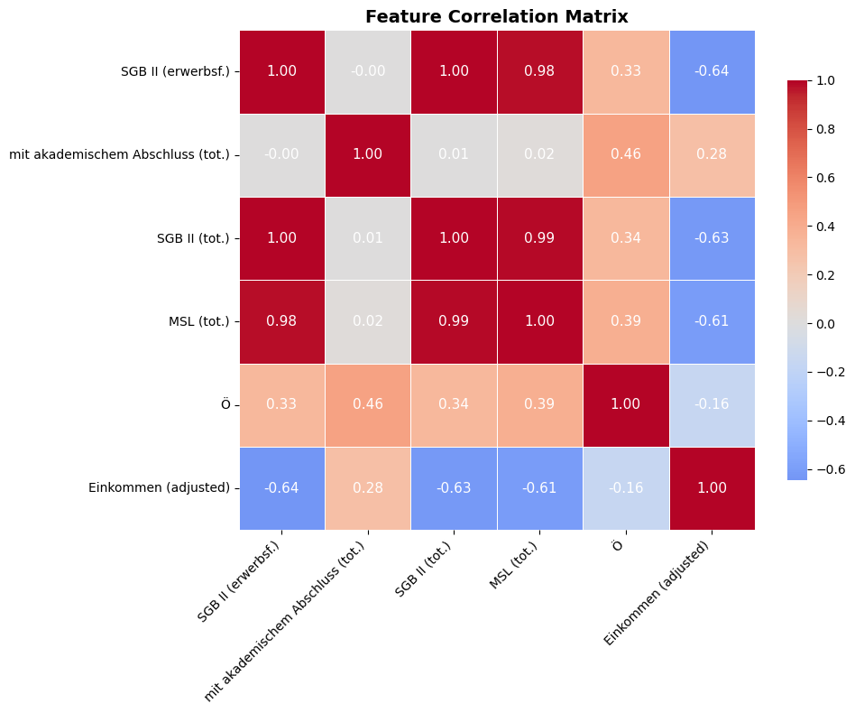
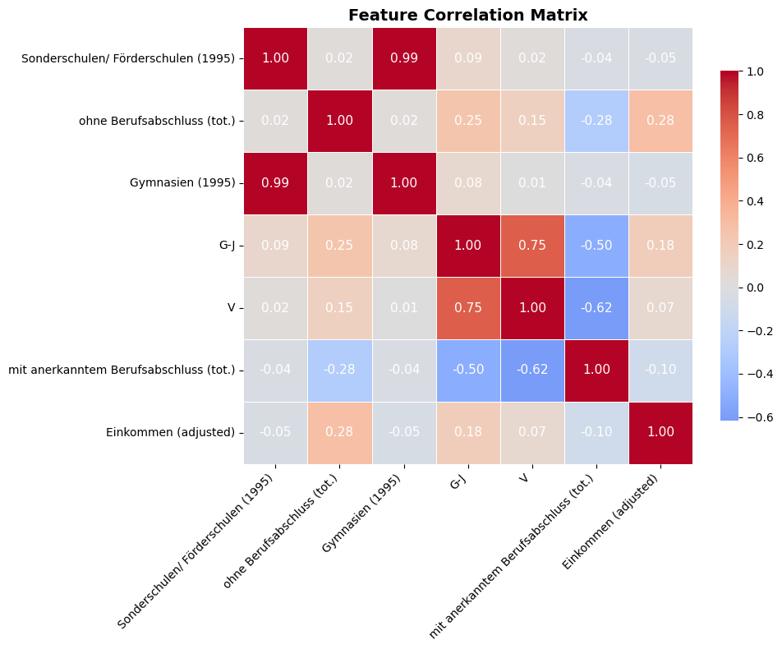
Classification
Feature Importance
Overfitted model
Not overfitted model
Top 5 Features by average rank | Rank
Standard benefit (employable) | 1.3 ± 0.7
Employed residents with academic degree (tot.) | 2.6 ± 1.0
Total standard benefit | 3.4 ± 1.8
Minimum income support benefits (tot.) | 5.2 ± 2.5
Employed persons in Public & Social Services | 5.9 ± 2.9
Top 5 Features by average rank | Rank
Sonderschulen/ Förderschulen (1995) | 2.9 ± 1.5
Employed residents without vocational degree (tot.) | 3.5 ± 3.3
Gymnasien (1995) | 4.4 ± 2.8
Employed persons in Trade & Transport (G-J) | 5.5 ± 4.1
Employed persons in Finance & Real Estate (V) | 6.8 ± 4.5

Slide 21
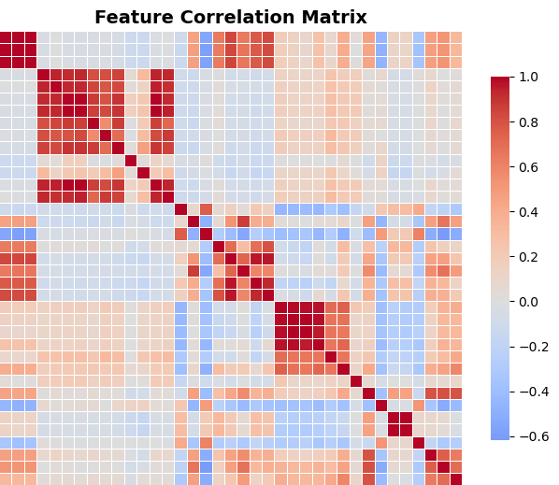
Highly correlated features
Highly correlated features hurt interpretability in MLR

Slide 22
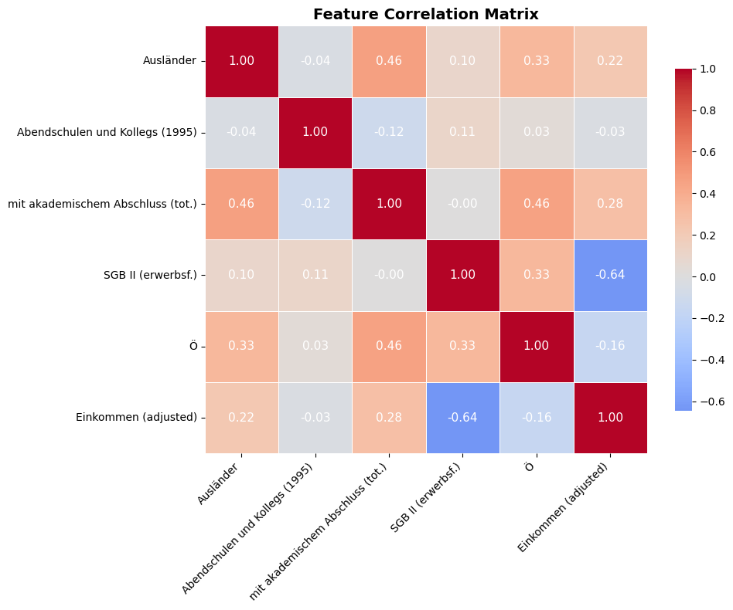
Weakly correlated features
Subset of features with weak to moderate correlation

Slide 23
Regression
Multiple Linear Regression
All features
Subset of features
R² Score: 0.67 ± 0.02
R² Score (train): 0.680 ± 0.005
RMSE: 1460 ± 80 €
R² Score: 0.54 ± 0.02
R² Score (train): 0.547 ± 0.006
RMSE: 1730 ± 90 €

Slide 24
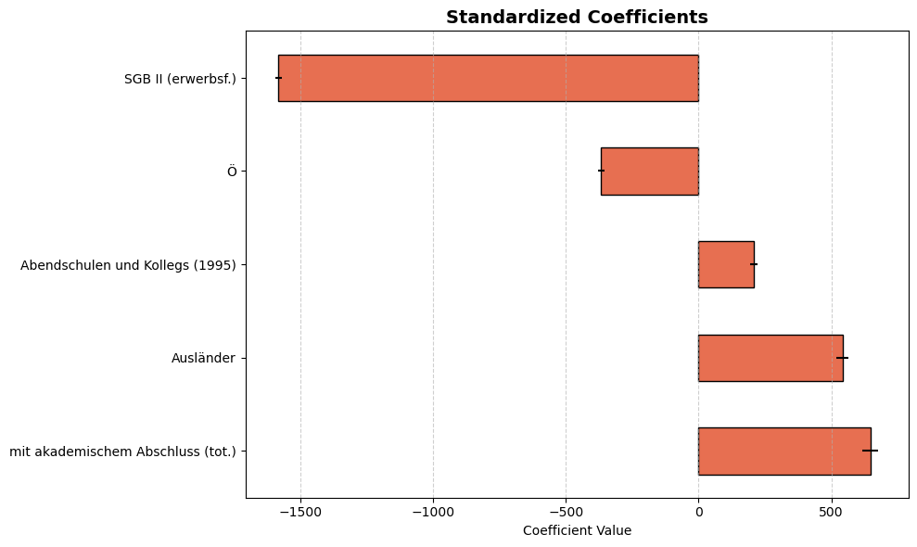
Regression
Subset of features
R² Score: 0.54 ± 0.02
R² Score (train): 0.547 ± 0.006
RMSE: 1730 ± 90 €

Slide 25
Conclusion
Education and social benefits are good predictors of income in regional aggregate data.
Number of schools per capita build in 1995 become good predictors for generalizable classifiers.
We could use a small ANN to allow non-linearities

Slide 26
USA (individuals data)

Slide 27

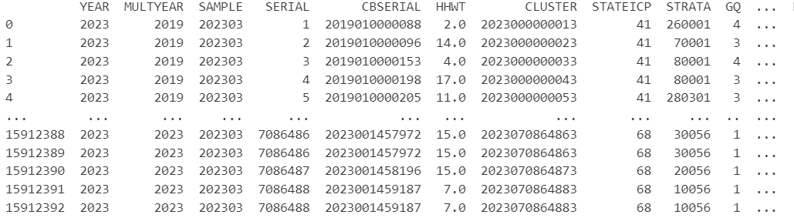
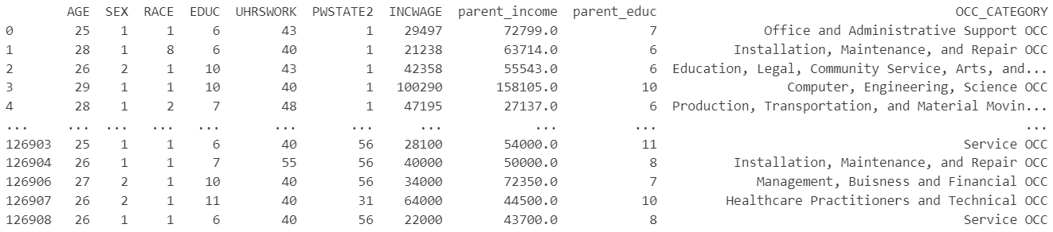
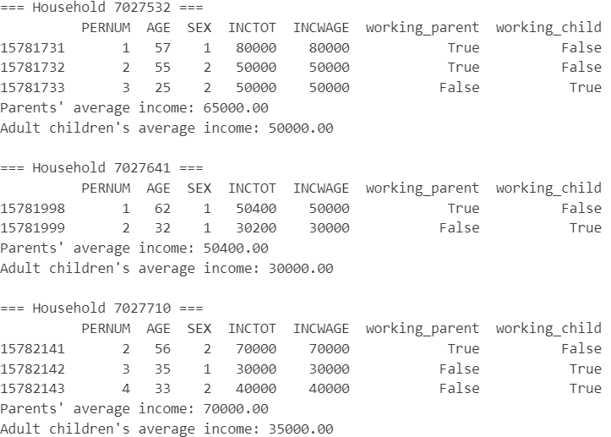
Features:
AGE: Age in years
SEX: Biological sex
RACE: Race codes
EDUC: Education codes
UHRSWORK: Usual hours worked per week
PWSTATE2: Place of work: state
INCWAGE: Income from wage
OCC_CATEGORY: Occupation code
Source 6)
Total number of individuals: 15912393
Data from 2019-2023
Sort by households
and identify
working child and working parent
Total number of individuals: 118215
Working child:
EMPSTAT (employment status = 1 or 2 (self-employed))
AGE: 25-35
INCWAGE (Income from wage): 15000-300000
UHRSWORK: >=35
Working parent:
EMPSTAT (employment status = 1 or 2 (self-employed))
INCTOT (Total income): 15000-300000
UHRSWORK: >=35

Slide 28
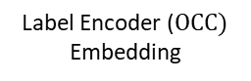
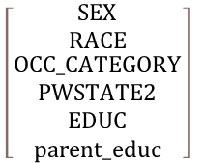
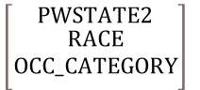


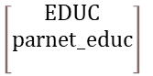
Model Architecture
Ordinal
$$\left[\begin{matrix}EDUC \\ parnet_educ \\ \end{matrix}\right]$$
Categorical
features
One-hot-encoder
Input layer
Input dimension: 50
Hidden layer 1
128 neurons
$$\left[\begin{matrix}SEX \\ RACE \\ \begin{aligned}OCC_CATEGORY \\ PWSTATE2 \\ EDUC \\ parent_educ\end{aligned}\end{matrix}\right]$$
Binary
Hidden layer 2
64 neurons
$$\left[SEX\right]$$
One-hot-encoder (RACE)
Categorical
Label Encoder ($OCC)$
Embedding
$$\left[\begin{matrix}PWSTATE2 \\ \begin{aligned}RACE \\ OCC_CATEGORY\end{aligned} \\ \end{matrix}\right]$$
Ouptut
INCWAGE
Numerical
features
Standard-Scaler
$$\left[\begin{matrix}AGE \\ UHRSWORK \\ parent_income\end{matrix}\right]$$
Activation function
ReLU()

Slide 29
Model Architecture
Input layer
Input dimension: 50
Hidden layer 1
128 neurons
ML Model
Optimizer Loss Max Epochs Batch sizes: Training/Validation/Test | Adam Mean Squared Error 100 64 80%/10%/10%
Hidden layer 2
64 neurons
Ouptut
INCWAGE
Activation function
ReLU()

Slide 30
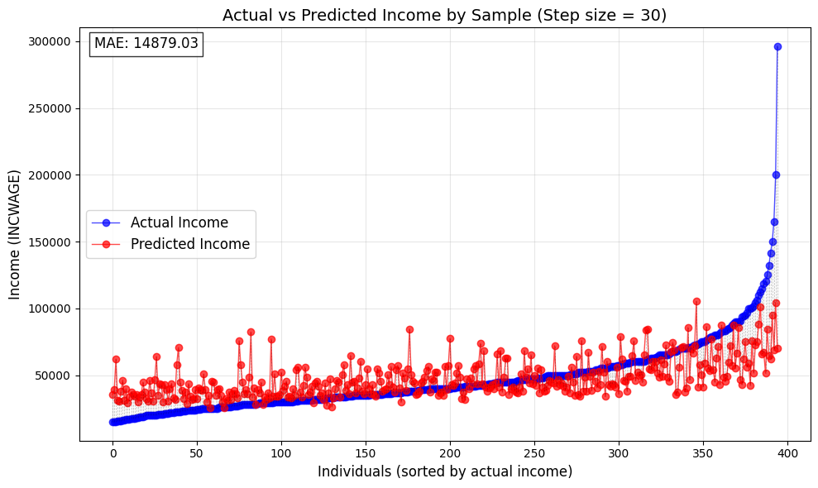
Accuracy
Metric | Loss
MAE RMSE R² Median Absolute Error Mean Absolute Percentage Error | $14985 $21975 0.29 $10684 36.27

Slide 31
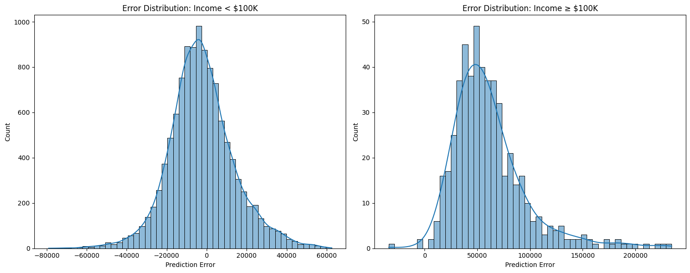
Accuracy

Slide 32
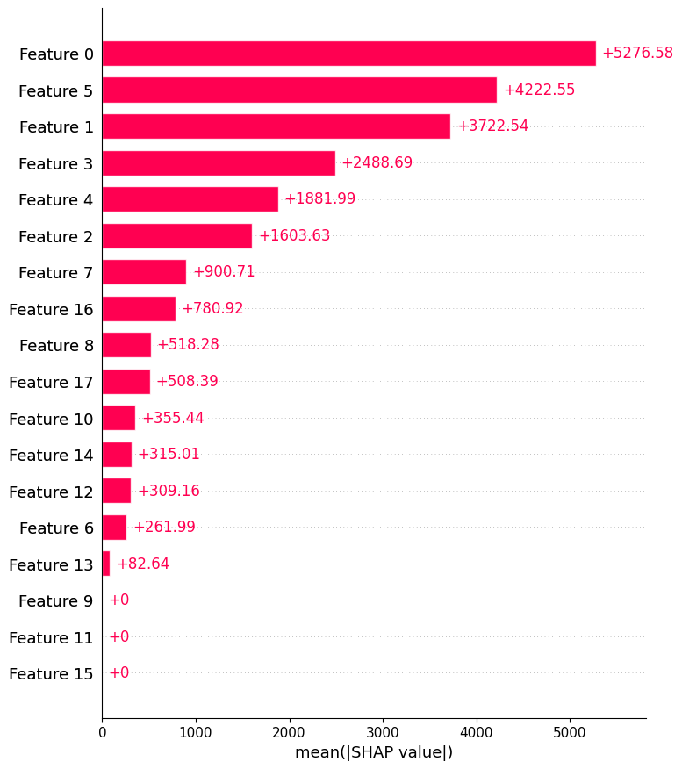
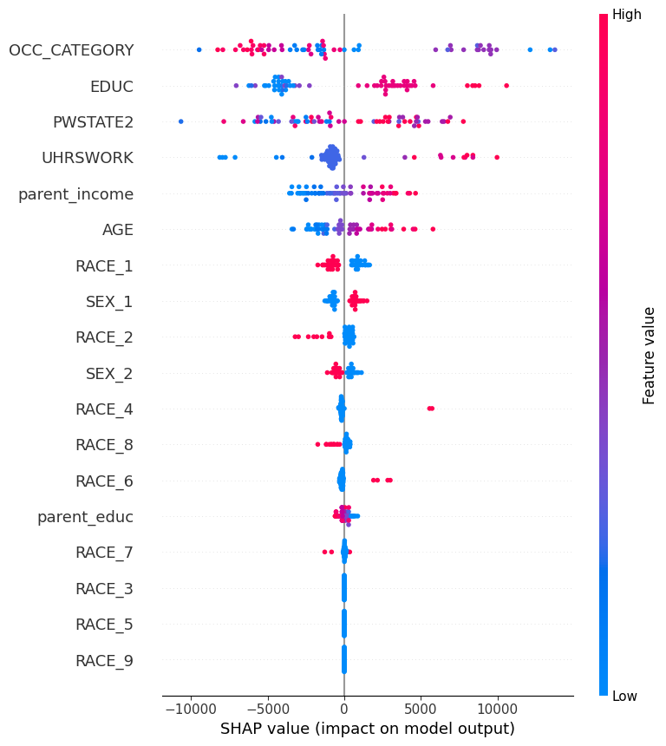
Feature Analysis
RACE = {
"White":1,
"Black":2,
"American Indian": 3,
"Chinese": 4,
"Japanese": 5,
"Other Asian": 6,
"Two major races": 8,
"Three or more major races": 9
}
SEX = {"Male":1,
"Female":2}

Slide 33
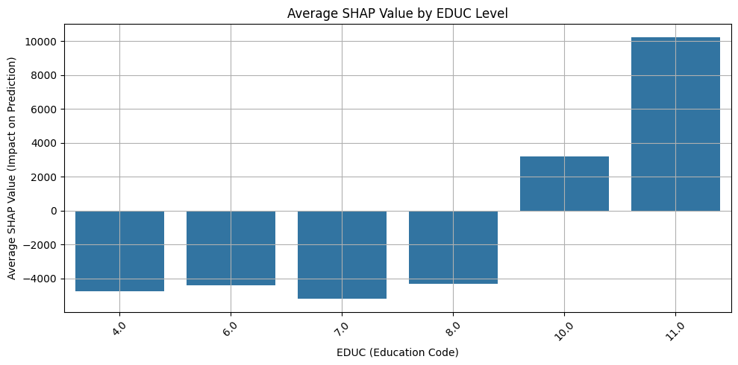
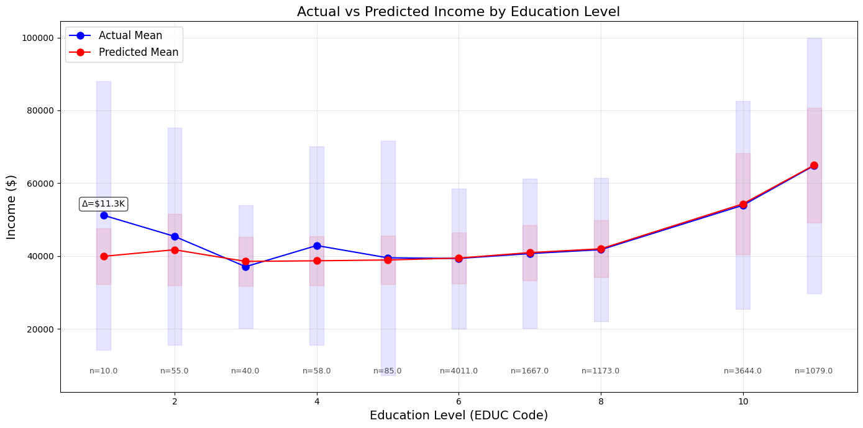
Feature Analysis

Slide 34
Conclusion
Thoughts
Improvements
Education is one of the most important factors indicating strong correlation between education and income
Higher Education leads to higher income
Neural network can make moderately good predictions for income within a certain income range (<100k)
Model struggles to predict incomes higher than 100k (indicating that specific features or factors may be responsible for higher income levels)
Utilize more features (Feature gap mitigation)
Data sparsity --> more Data necessary
Feature engineering (Engineer features which target hidden determinats of high incomes)

Slide 35
India (household data)

Slide 36
India - Dataset IHDS
Characteristics
Preprocessing
India Human Development Survey
Size: 41’554 housesholds
Variaty: 937 variables
Timespan:
IHDS1: 2004-2005
IHDS2: 2011-2012
IHDS3: ?
Pick the interesting features
Cleaning the data in terms of
Positive Income
Missing values: ‘’ or ‘ ‘
Numeric Data Type
Convert to Tensors and Dictionaries

Slide 37
Features
Location
Stateid, Distid, Distname
Education
Highest male / female education
At least one literate adult
Family
Number of children in HH
Number of persons in HH
Geographic
Urban
Metro
Religion and Caste
Brahmins, …, Dalits
Muslims, Sikhs, Jains, Christians
Household assests
Computer, Car, HHassets

Slide 38
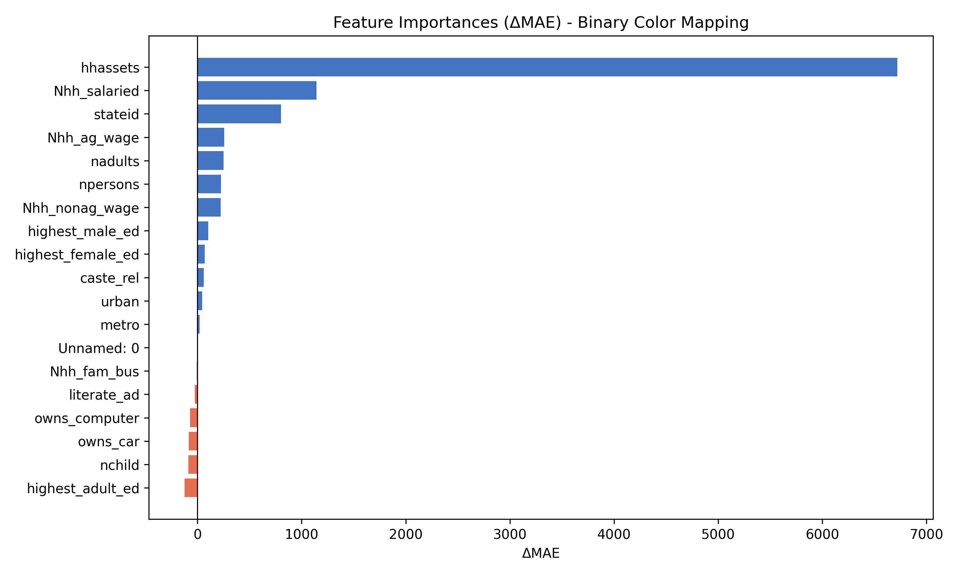
Features
Location
Stateid, Distid, Distname
Education
Highest male / female education
At least one literate adult
Family
Number of children in HH
Number of persons in HH
Geographic
Urban
Metro
Religion and Caste
Brahmins, …, Dalits
Muslims, Sikhs, Jains, Christians
Household assests
Computer, Car, HHassets

Slide 39
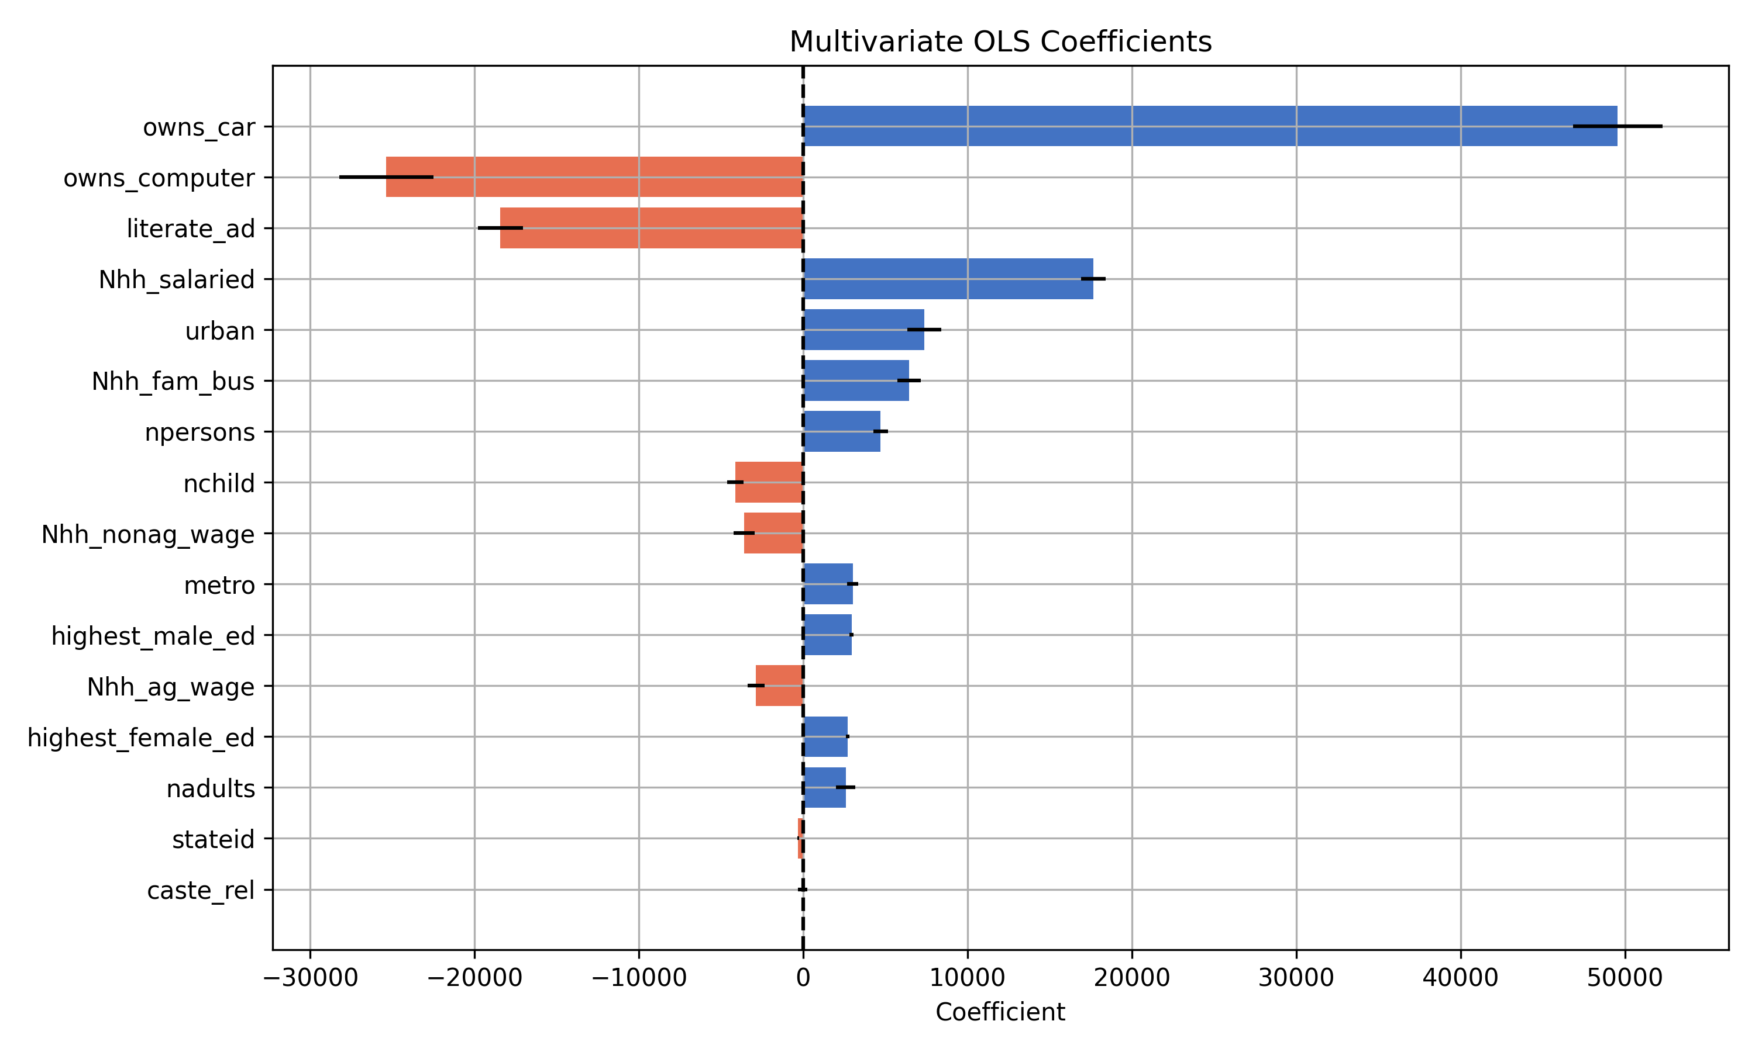
Regression

Slide 40
Regression
Metric | Loss
R2 Score | 0.206
Skewness | 5.6
Kurtosis | 61
High coefficients
Unreasonable coefficients

Slide 41
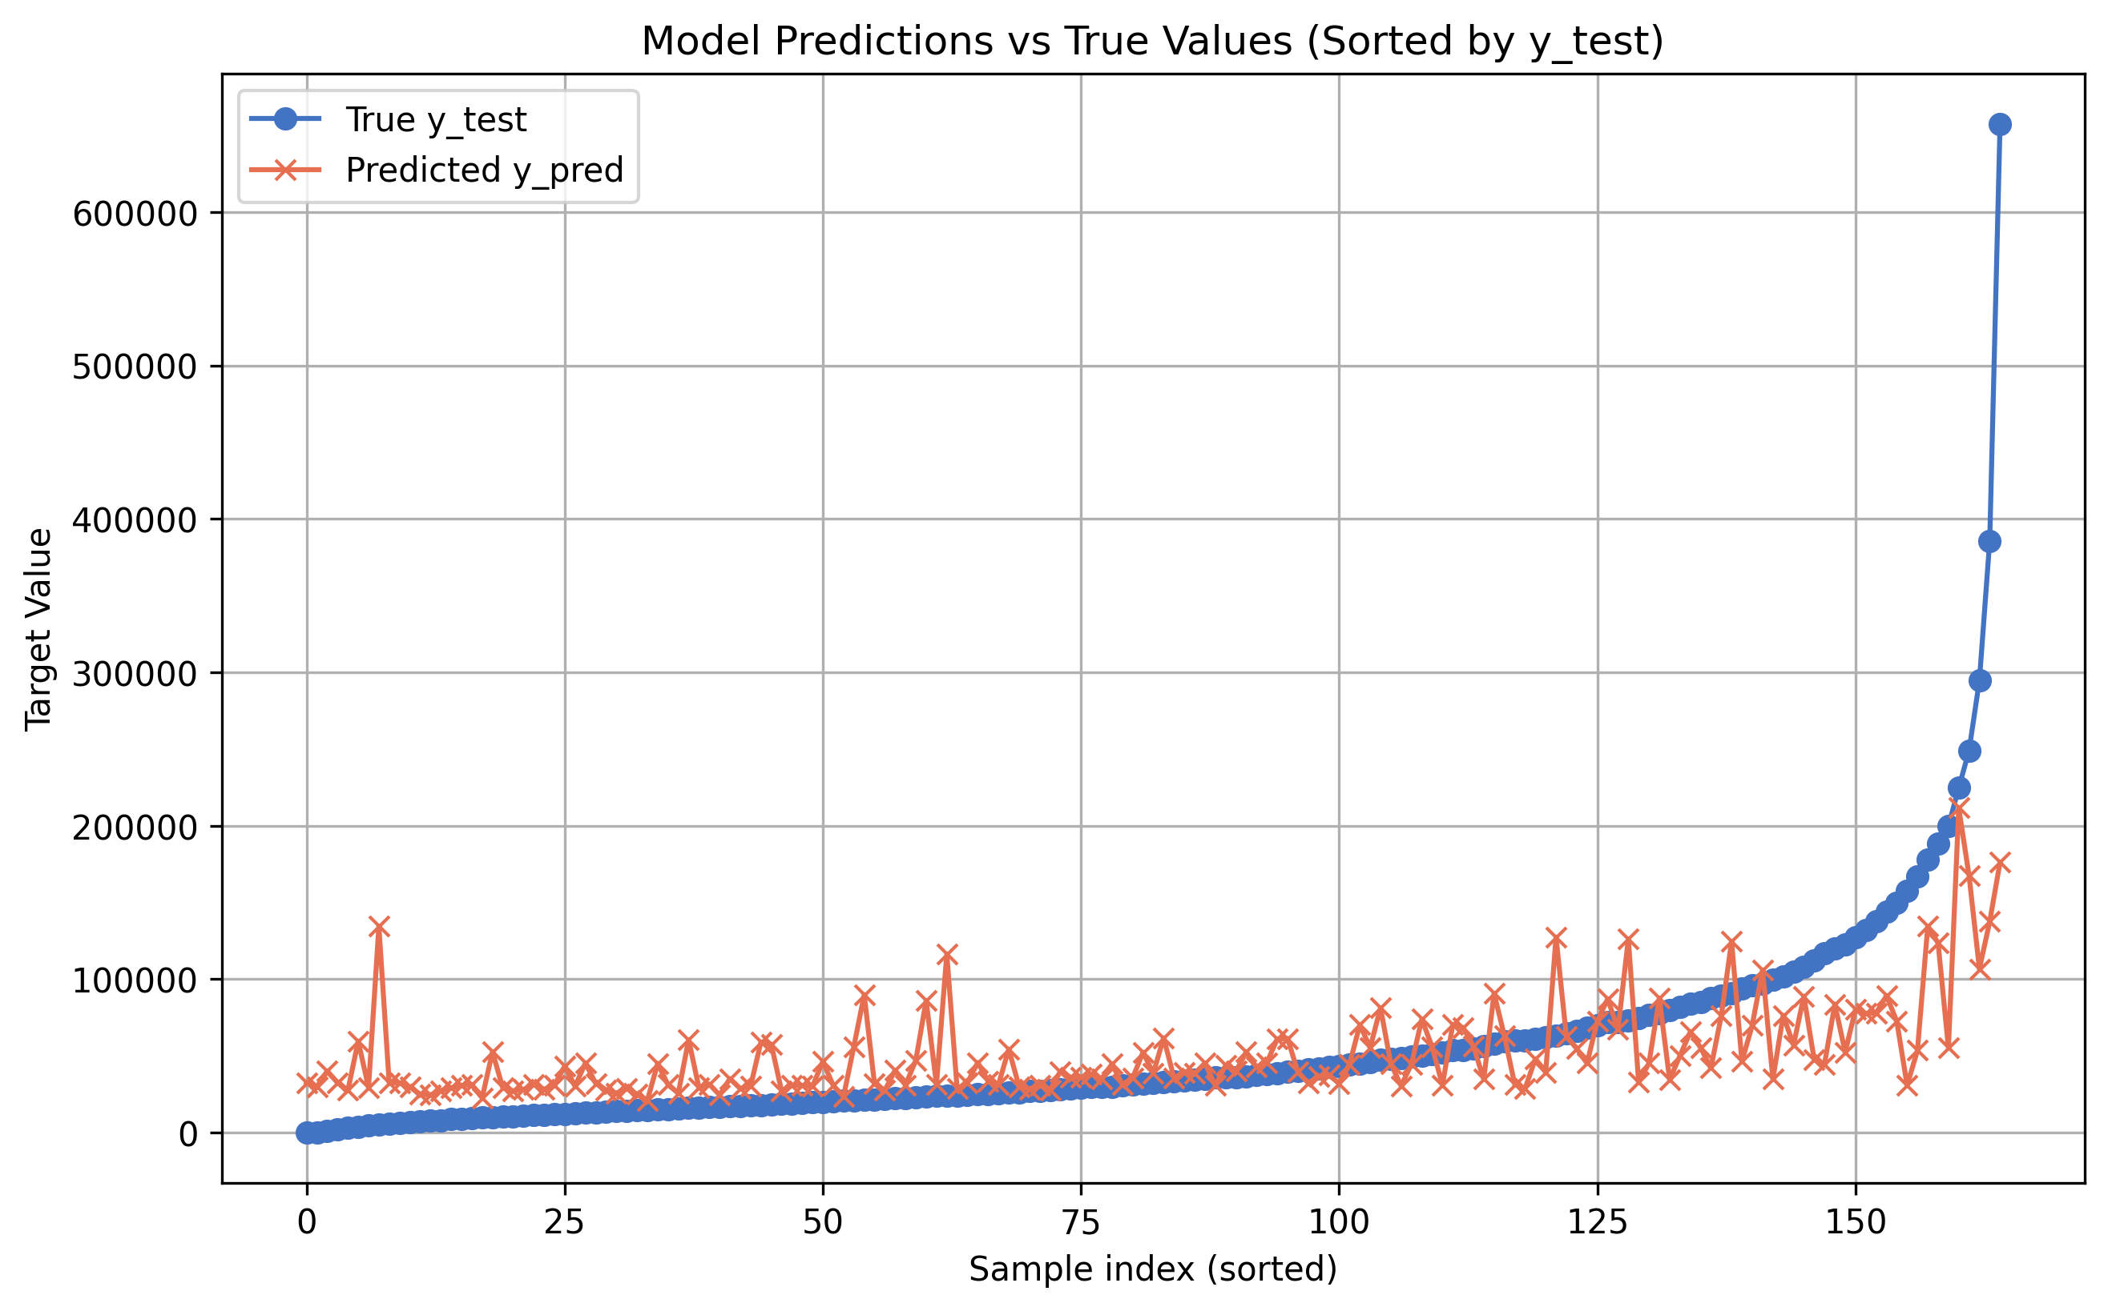
Predictions

Slide 42
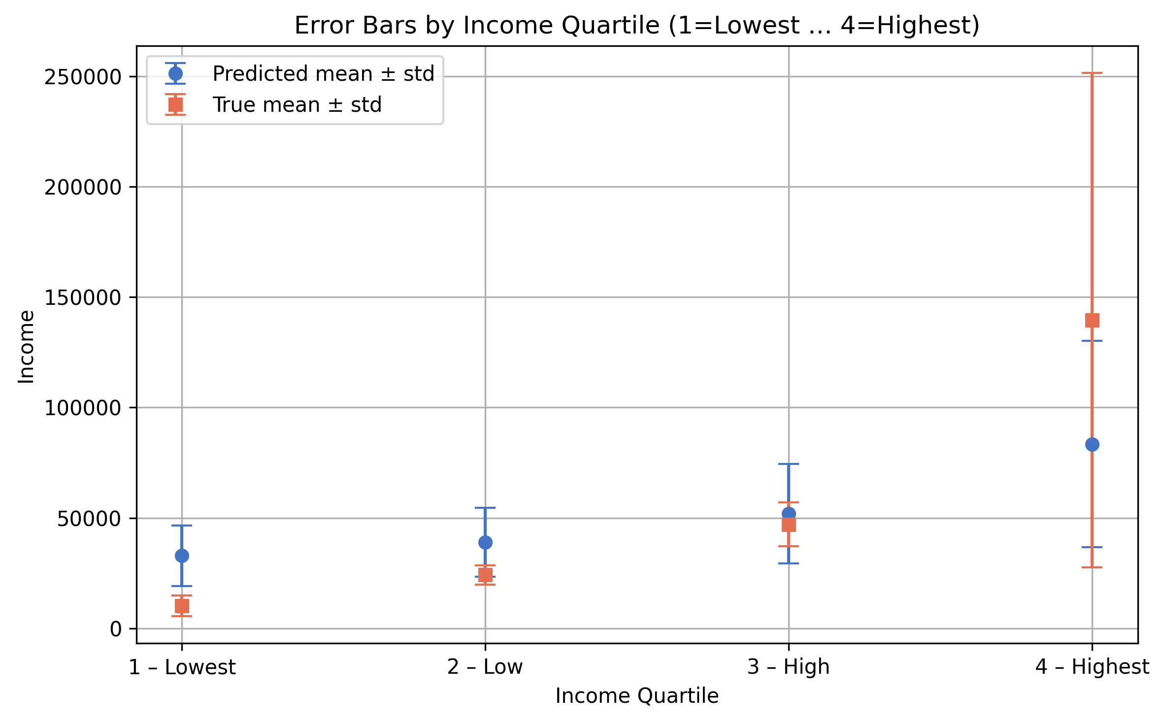
Accuracy

Slide 43
Accuracy (cont.)
R2 Score | Skewness | Kurtosis
0.309 | 2 | 26
Metric | Loss | Conversion | Loss
L1 Loss MAE | 29’397 Rupee | 0,0098 | 287 CHF
1 – Lowest | 22’659 Rupee | “ | 222 CHF
2 – Low | 15’028 Rupee | “ | 147 CHF
3 – High | 15’685 Rupee | “ | 153 CHF
4 – Highest | 64’234 Rupee | “ | 629 CHF

Slide 44
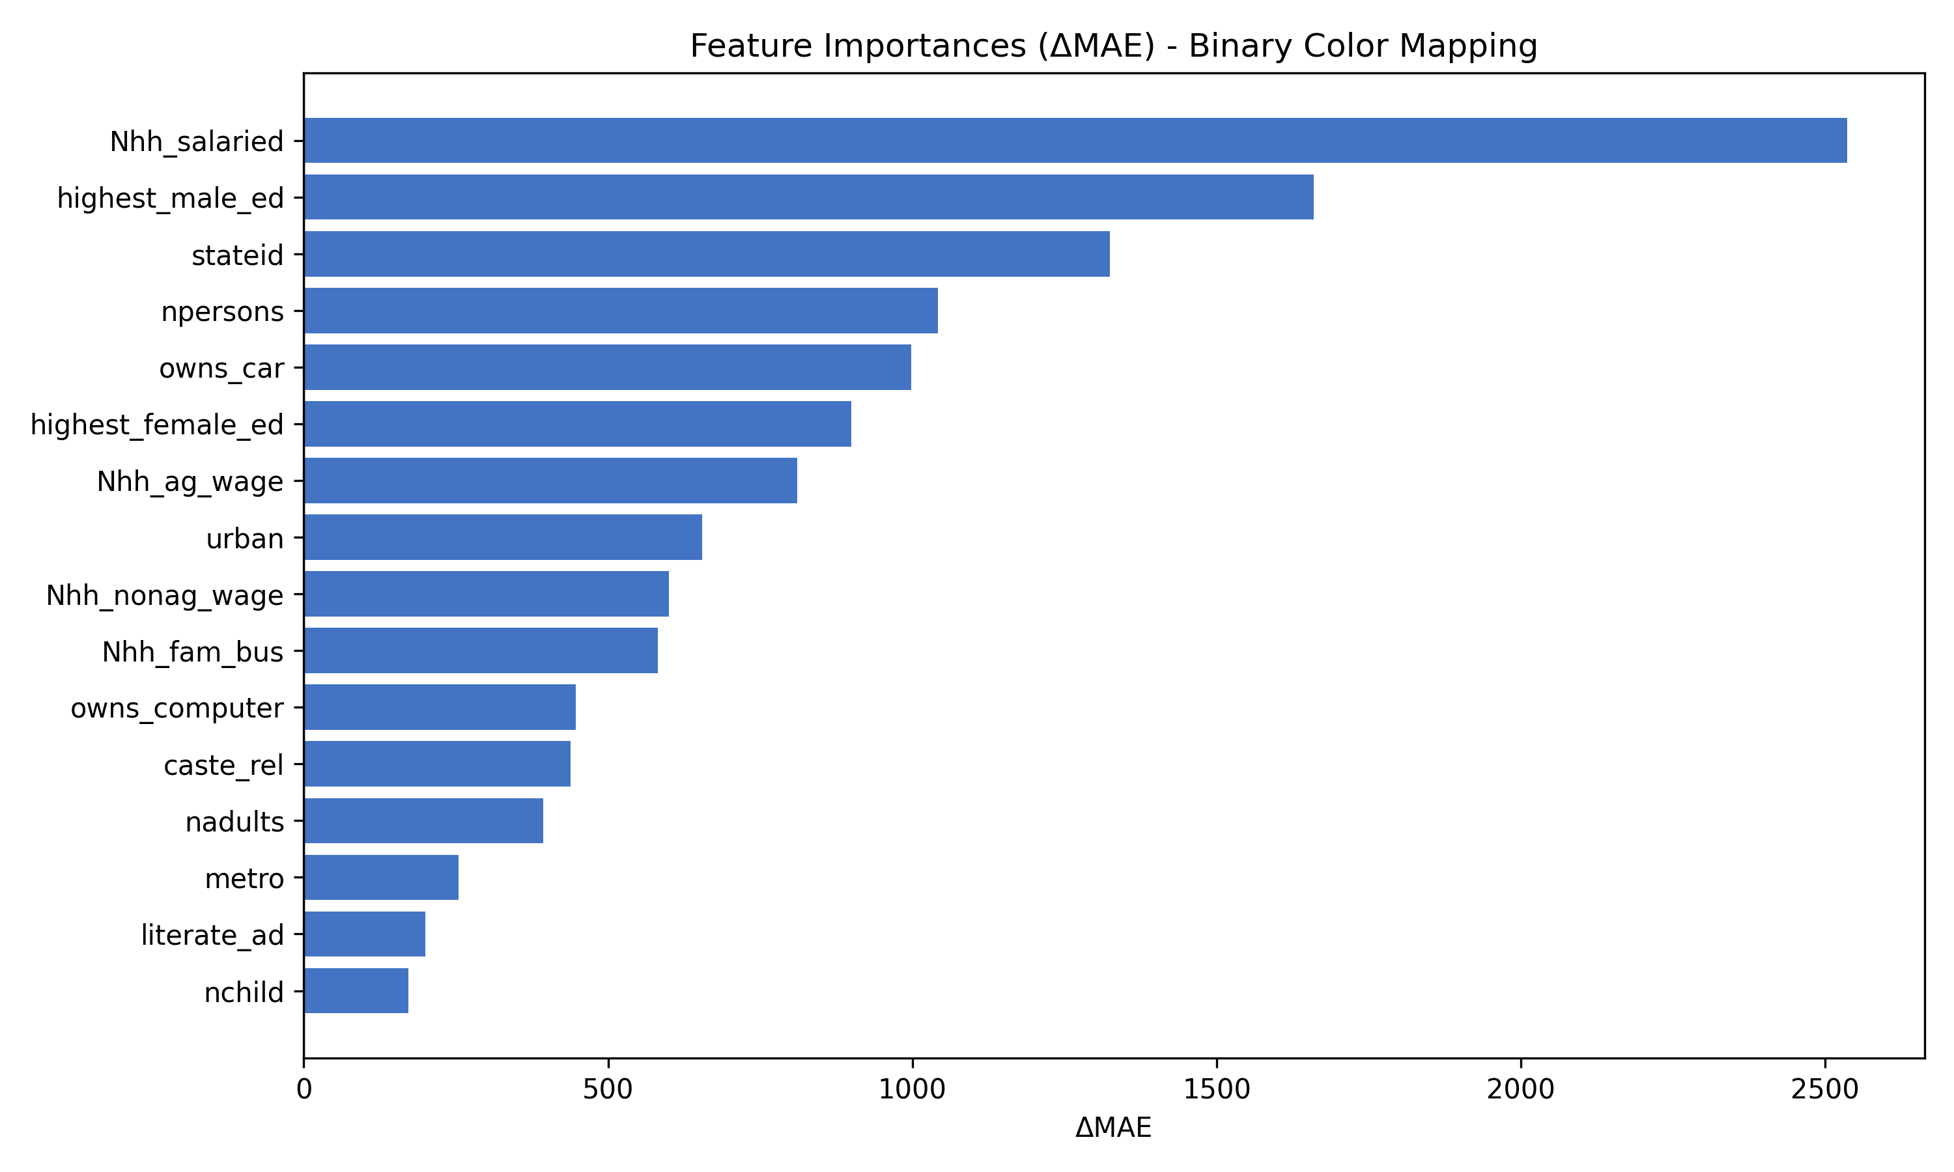
Sensitivity Analysis

Slide 45
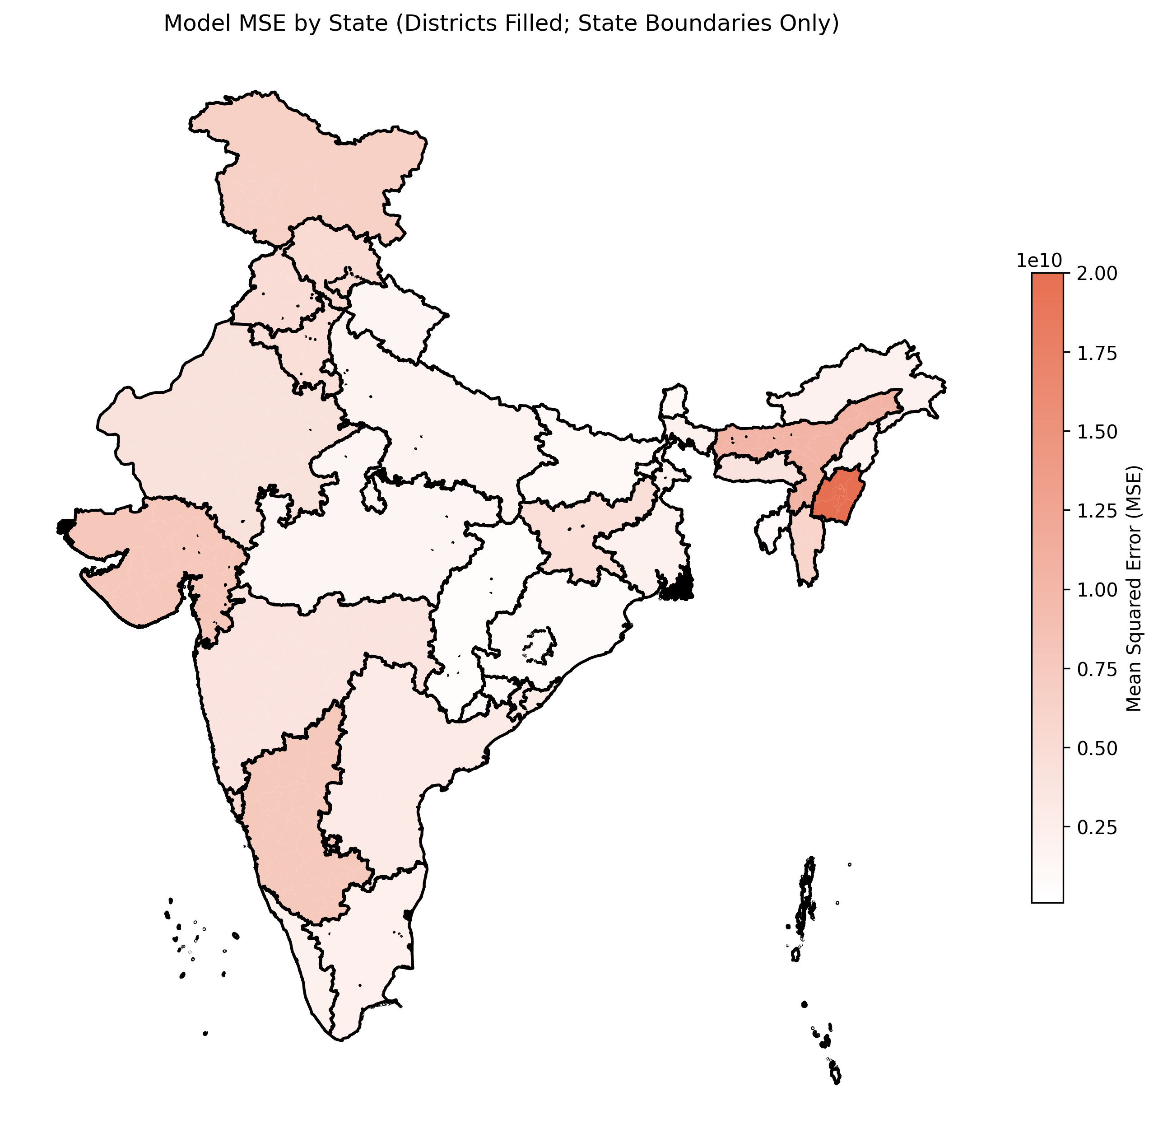
Bias and Fairness

Slide 46
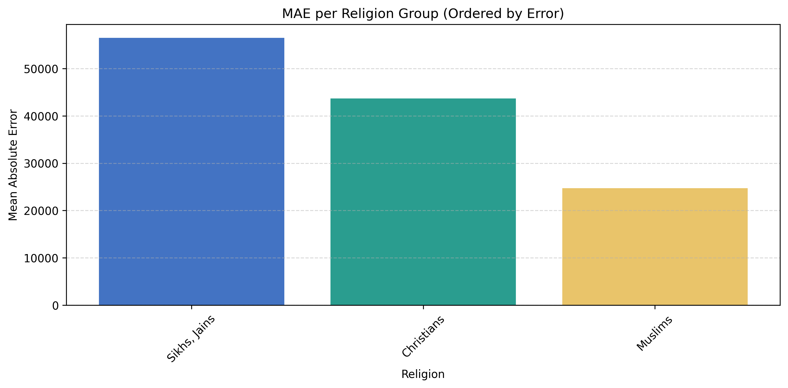
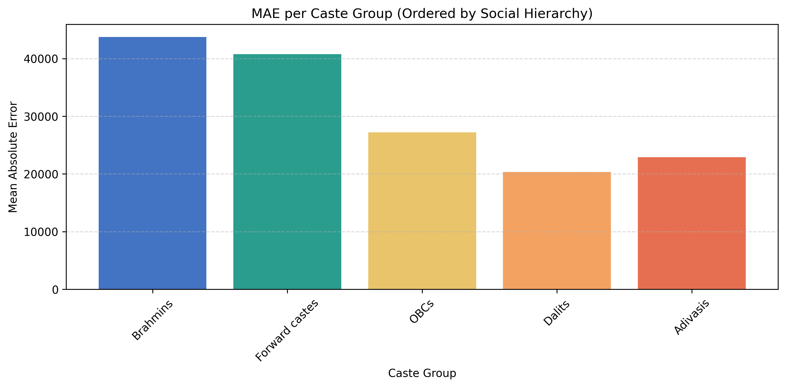
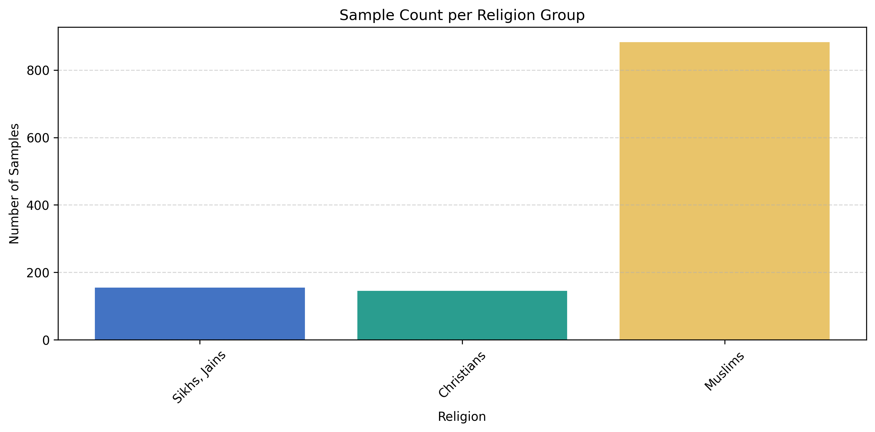
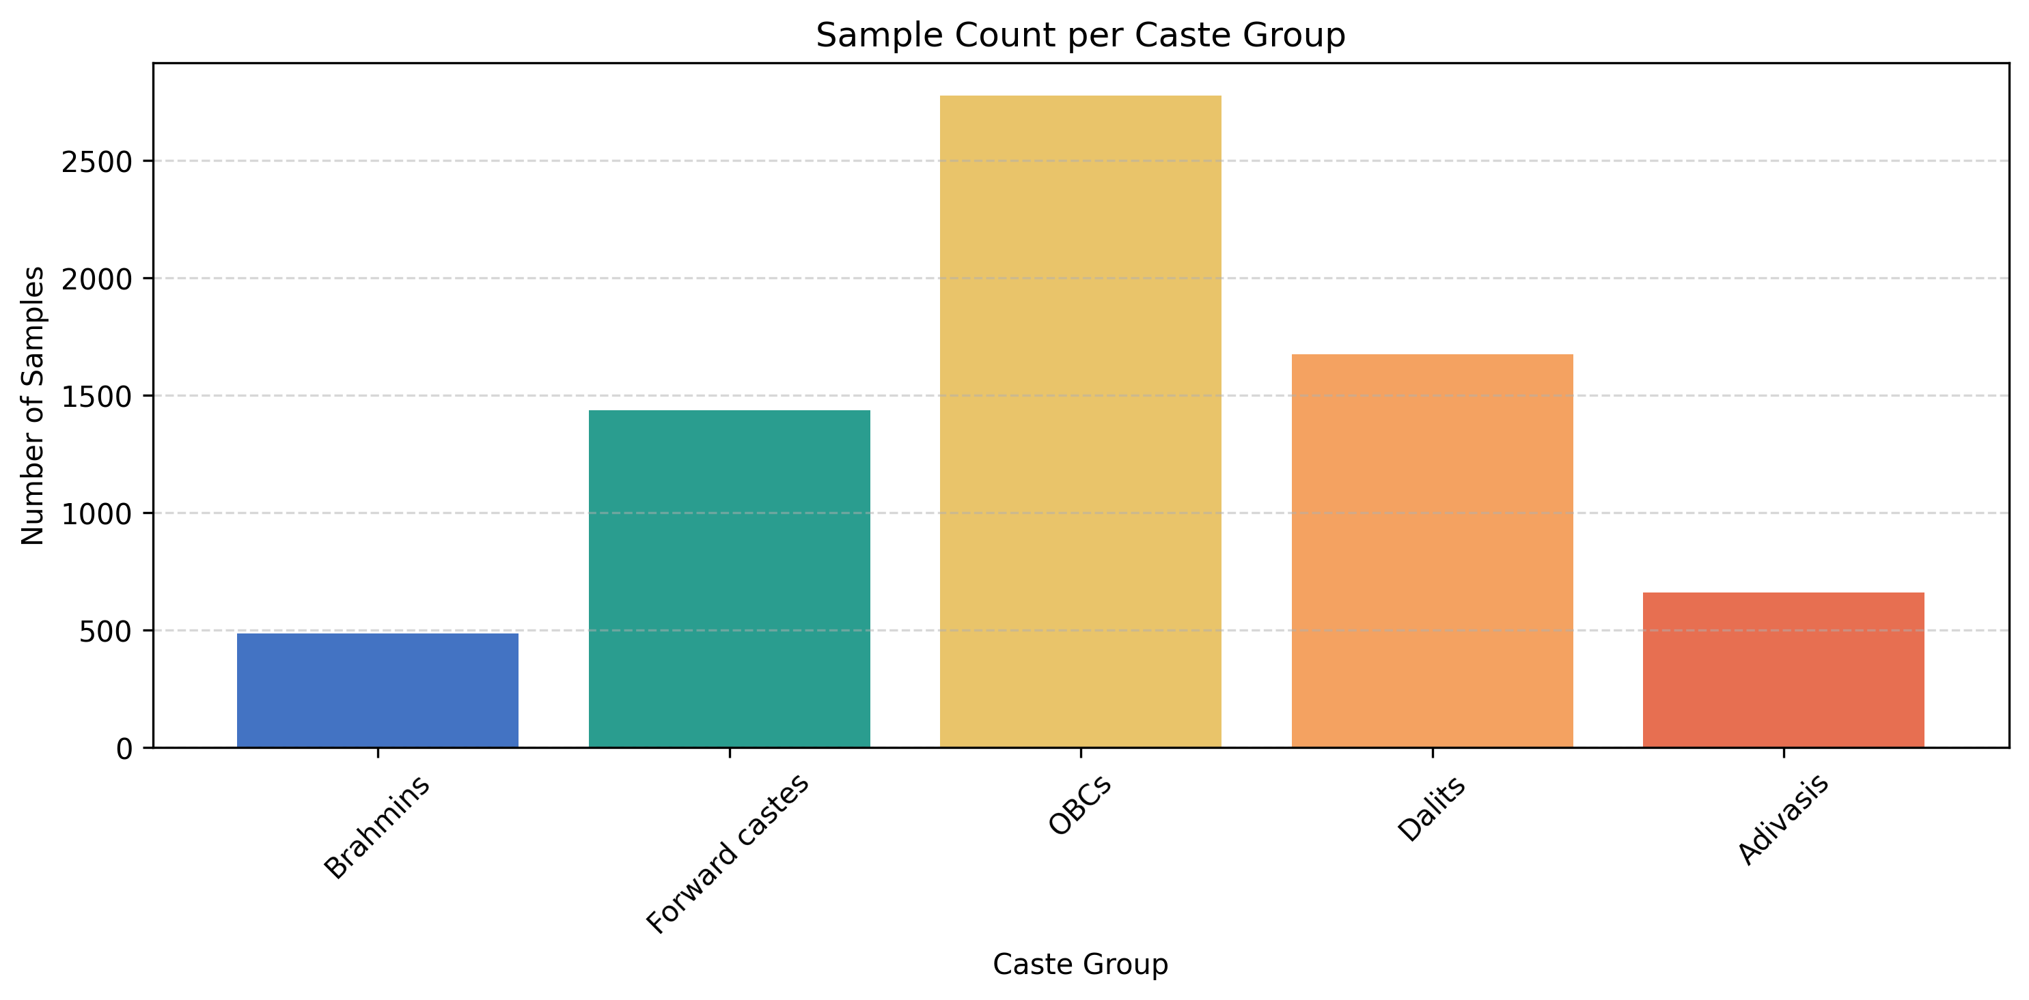
Bias and Fairness (cont.)

Slide 47
Conclusion
Thoughts
Improvements
Neural network captures non-linear relationships in the data that simple linear regression misses
Highest male education emerged as one of the most influential features, indicating strong correlation between education and household income.
Fairness concerns: Model performance varies significantly across caste an religion groups. (Bias or data imbalance)
Model struggles with extremes or outliers: as observed in the residual analysis
Focus on HH with <= 200’000 Rupee income Try to improve model calibration and consider training a separate model for both segments.
Temporal information
External data enrichment
Feature engineering

Slide 48
Summary
Performance: R²
Conclusion
US (aggregate) | Germany (aggregate) | US (individuals) | India (individuals)
~0.9 | ~0.7 | ~0.3 | ~0.3
Aggregate income data are easier to predict than the income of individuals using socioeconomic factors (incl. education)
Individuals exhibit more variance for similar backgrounds
More factors are needed to know individual behaviour and environment important for predicition
→ Higher number of samples and features are needed, but unrealistic to receive such detailed and extensive datasets

Slide 49
Future Work
Improvements
Additional Analysis
Feature engineering
Compare prediction of more ML model
Comparisons intercontinental: Use the same features and similar ML Models across countries to better assess the difference in feature importance across regions. e.g. predict income in USA for individual living in India
Agent-based modelling to better understand interaction between individuals and explore emergent behaviour

Slide 50
Reference/ Literature/ Further Reading
Sources
Link
ACS: 5-Year Estimates Data Profiles
Tiger: Shapefile
Regionaldatenbank Deutschland
Geobasis DE VG250 (Shapefile)
IPUMS US, custom dataset
IHDS
Shapefile (Github)
Github
https://data.census.gov/table?d=ACS+5-Year+Estimates+Data+Profiles
https://www2.census.gov/geo/tiger/
https://www.regionalstatistik.de/genesis/online
https://gdz.bkg.bund.de/index.php/default/digitale-geodaten/verwaltungsgebiete/verwaltungsgebiete-1-250-000-stand-01-01-vg250-01-01.html
https://www.icpsr.umich.edu/web/DSDR/studies/22626
https://github.com/AnujTiwari/India-State-and-Country-Shapefile-Updated-Jan-2020
IPUMS USA
https://github.com/simon-0006/Data-Science-GESS---Group-Project/tree/main

Slide 51
Questions?

Slide 52
Declaration of Originality
We hereby declare that this work is the result of our own original effort and has not been submitted, either in whole or in part, for academic credit at any other institution. All sources of information used in this work have been properly acknowledged, and all quotations are clearly indicated.
We affirm that each of us contributed to the work and are collectively responsible for its content. We understand the academic integrity policies of ETHZ and acknowledge the consequences of plagiarism or misrepresentation.

Slide 53
Contributions of Team Members
Content
Name
Country: US, Level: County
Country: Germany, Level: County
Country: India, Level: Household
Country: US, Level: Individual
Pascal Gisiger
Erisa Ismaili
Simon Ganter
Baban Deep Virk

Slide 54
Backup Slides- Germany

Slide 55
Possible Features
Minimum income support benefits
Employed Residents
Employed persons (at place of work)
Schools (1995)
Unemployed Residents
Target:
Mean Household INcome

Slide 56
Possible Features
Minimum income support benefits
Employed Residents
With an academic degree
With recognized vocational degree
Without vocational degree
(total and foreign)
Total standard benefit under SGB I (employable and non-employable)
Assistance for living expenses
Old age and disability
Asylum Seekers Benefit
Employed persons (at place of work)
Schools (1995)
Agriculture
Industry
Manufacturing
Construction
Trade & Transport
Finance & Real Estate
Public & Social Services
Gymnasien
Hauptschulen
Realschulen
Integrierte Gesamtschulen
Sonderschulen / Förderschulen
Schularten mit mehreren Bildungsgängen
Unemployed Residents
15-20 years
15-25 years
55-65 years
Foreign
Disabled
Longterm
Target:
Mean Household INcome

Slide 57
Possible Features
Normalize by 15-65 years population within a Regional Unit
Minimum income support benefits
Employed Residents
With an academic degree
With recognized vocational degree
Without vocational degree
(total and foreign)
Total standard benefit under SGB I (employable and non-employable)
Assistance for living expenses
Old age and disability
Asylum Seekers Benefit
Employed persons (at place of work)
Schools (1995)
Agriculture
Industry
Manufacturing
Construction
Trade & Transport
Finance & Real Estate
Public & Social Services
Gymnasien
Hauptschulen
Realschulen
Integrierte Gesamtschulen
Sonderschulen / Förderschulen
Schularten mit mehreren Bildungsgängen
Unemployed Residents
15-20 years
15-25 years
55-65 years
Foreign
Disabled
Longterm
Target:
Mean Household INcome

Slide 58
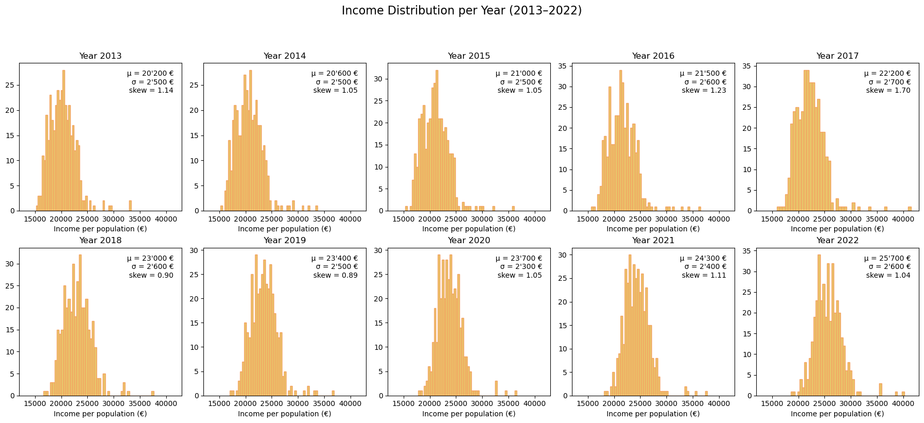
Income distribution

Slide 59


Income distribution (adjusted)

Slide 60
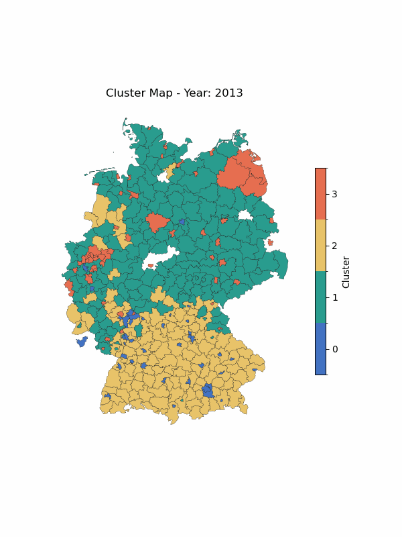
Clustering

Slide 61
Backup Slides- US (individual)

Slide 62
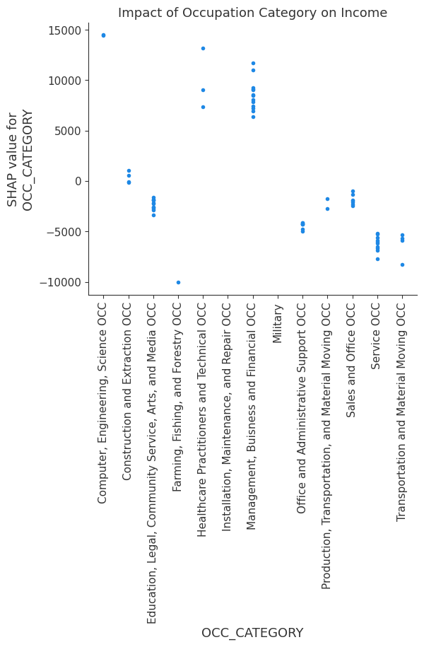
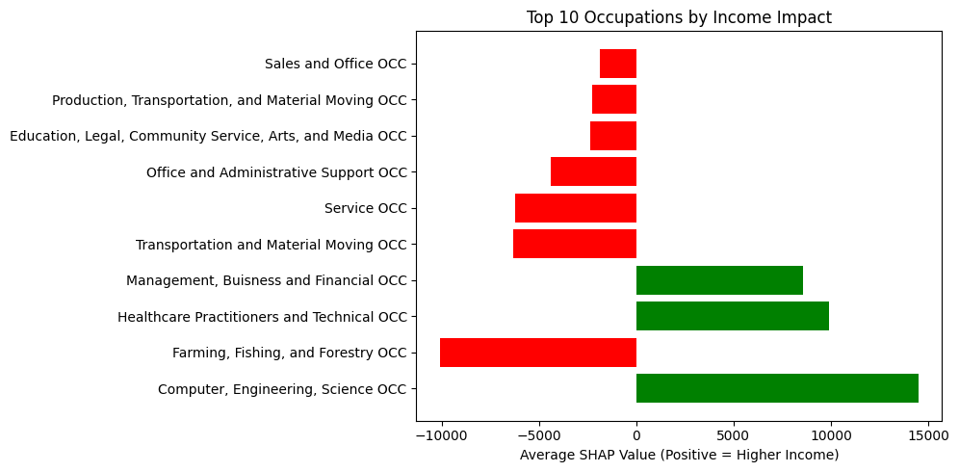
INCOME BY OCC

Slide 63
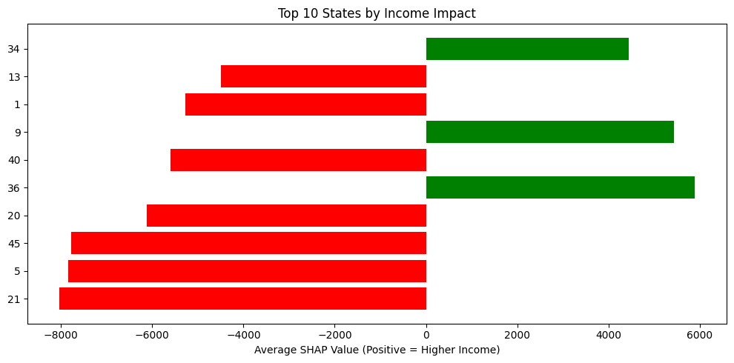
INCOME BY STATE

Slide 64
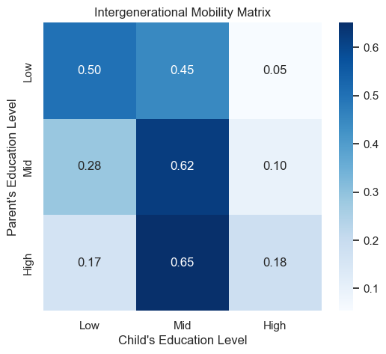
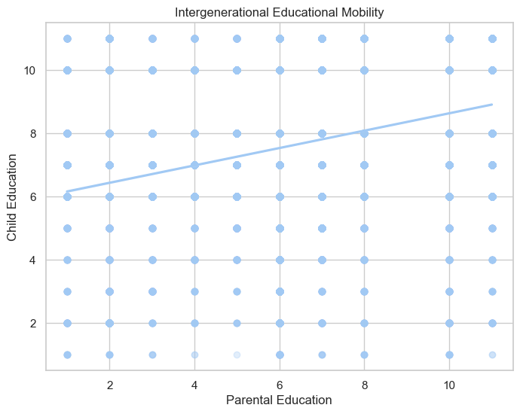
CHILD/PARENT EDUC

Slide 65
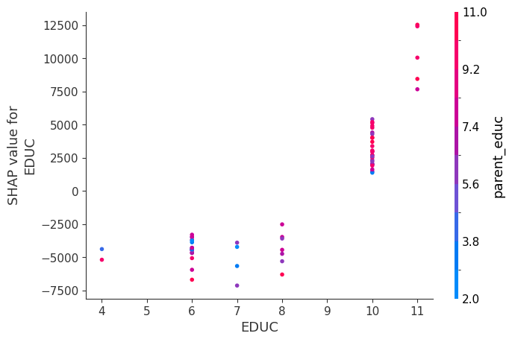

CHILD/PARENT EDUC

